Slide 1




Introduction to MNE-Python Workshop
Tehran Garden 2023.10.18
Presentation by: Sara Rostami Alireza Mahdavi

Slide 2
Outline
Intro to MNE-Python
Design Principles
Feature Overview
Collaborative Tools
Example Usage
Resources

Slide 3
Intro to MNE-Python
Open-source Python package for working with Signals (EEG, MEG, ECoG, etc.)
Originated as a Python port of the MNE software written in C by MEG researcher Matti Hämäläinen
MNE originally stood for Minimum Norm Estimation
Facilitated the development of the software by employing a widely-accessible and familiar language to the scientific community, namely Python
It is very well-documented including a large number of tutorials and examples of how to perform specific operations, as well as a complete API

Slide 4
MNE-Python Design Principles
Provide a powerful but easy-to-use scripting interface (no GUI yet)
Implement all features of the MNE MATLAB toolbox
Simplicity, clean code, and good documentation
Computationally efficient implementation, use parallel processing
Permissive BSD license
Open development on Github
Do not depend on any commercial software

Slide 5
Feature Overview - Preprocessing and IO
Flexible Data Loading: Supports various EEG/MEG data formats.
Efficient Data Structures: Raw and Epoch objects for data management.
Effective Filtering: High-pass, low-pass, band-pass, and band-stop filtering.
Artifact Removal: Automated/manual removal of EOG, ECG artifacts using ICA and SSP.
Epoching Capability: Segmentation of data into specific time periods (epochs).
Baseline Correction: Adjusts data relative to specific event onset time.
Resampling: Ability to change data sampling rate for consistency.

Slide 6
Feature Overview - Source Modeling
Diverse Estimation Methods: MNE, beamformers (LCMV, DICS), and distributed models (sLORETA, eLORETA).
Head Modeling: Create head models, compute forward solutions (BEM, spherical models).
Inverse Problem Solving: Estimate neural sources from sensor data (fixed, adaptive methods).
Cortical Parcellations: Analyze source activity in specific brain regions using brain atlases.
Visualization Tools: Display source estimates on brain surface for interpretation.
Save source space data as .stc, .w, or .nii.gz (4D NIfTI) file
Read and visualize dipole fit (.dip) files

Slide 7
Feature Overview - Time-Frequency Analysis
Diverse Decomposition Methods: Morlet wavelets, multitaper, short-time Fourier transform.
Spectral Power and Phase Analysis: Explore amplitude and phase modulations in various frequency bands.
Induced vs. Evoked Responses: Differentiate between non-phase-locked (induced) and phase-locked (evoked) responses.
Time-Frequency Visualization: Display dynamic changes in oscillatory activity over time and frequencies.
Event-Related Analysis: Calculate and visualize Event-Related Spectral Perturbation (ERSP) and Inter-Trial Coherence (ITC).

Slide 8
Feature Overview (Cont.)
Connectivity Estimation
Sensor space and source space
Flexible configuration of seed-based or all-to-all connectivity
Supported measures: Coherence, Imag.
Coherence, PLV, PLI, WPLI, ... Computationally efficient
Statistics
F test, permutation T test, repeated measures ANOVA
Non-parametric cluster statistics

Slide 9
Feature Overview (Cont.)
ICA
Decompose raw and epochs MEG and EEG data
Extract and visualize sources
Automatically identify sources using scipy distance metrics, correlation or custom functions
Export sources to raw object to apply mne-python sensor-space techniques in ICA space or to browse sources using mne_browse_raw
Efficient: speed and memory optimized, exclude non-stationary segments from fit
Persistence: decompose once, then save the ICA to later update the selection
Embedded Exporters
use .as_data_frame method to export raw, epochs and evoked data to the Pandas data analysis library
use .to_nitime method to export raw, epochs, evoked and source estimates data to the NiTime time series library

Slide 10


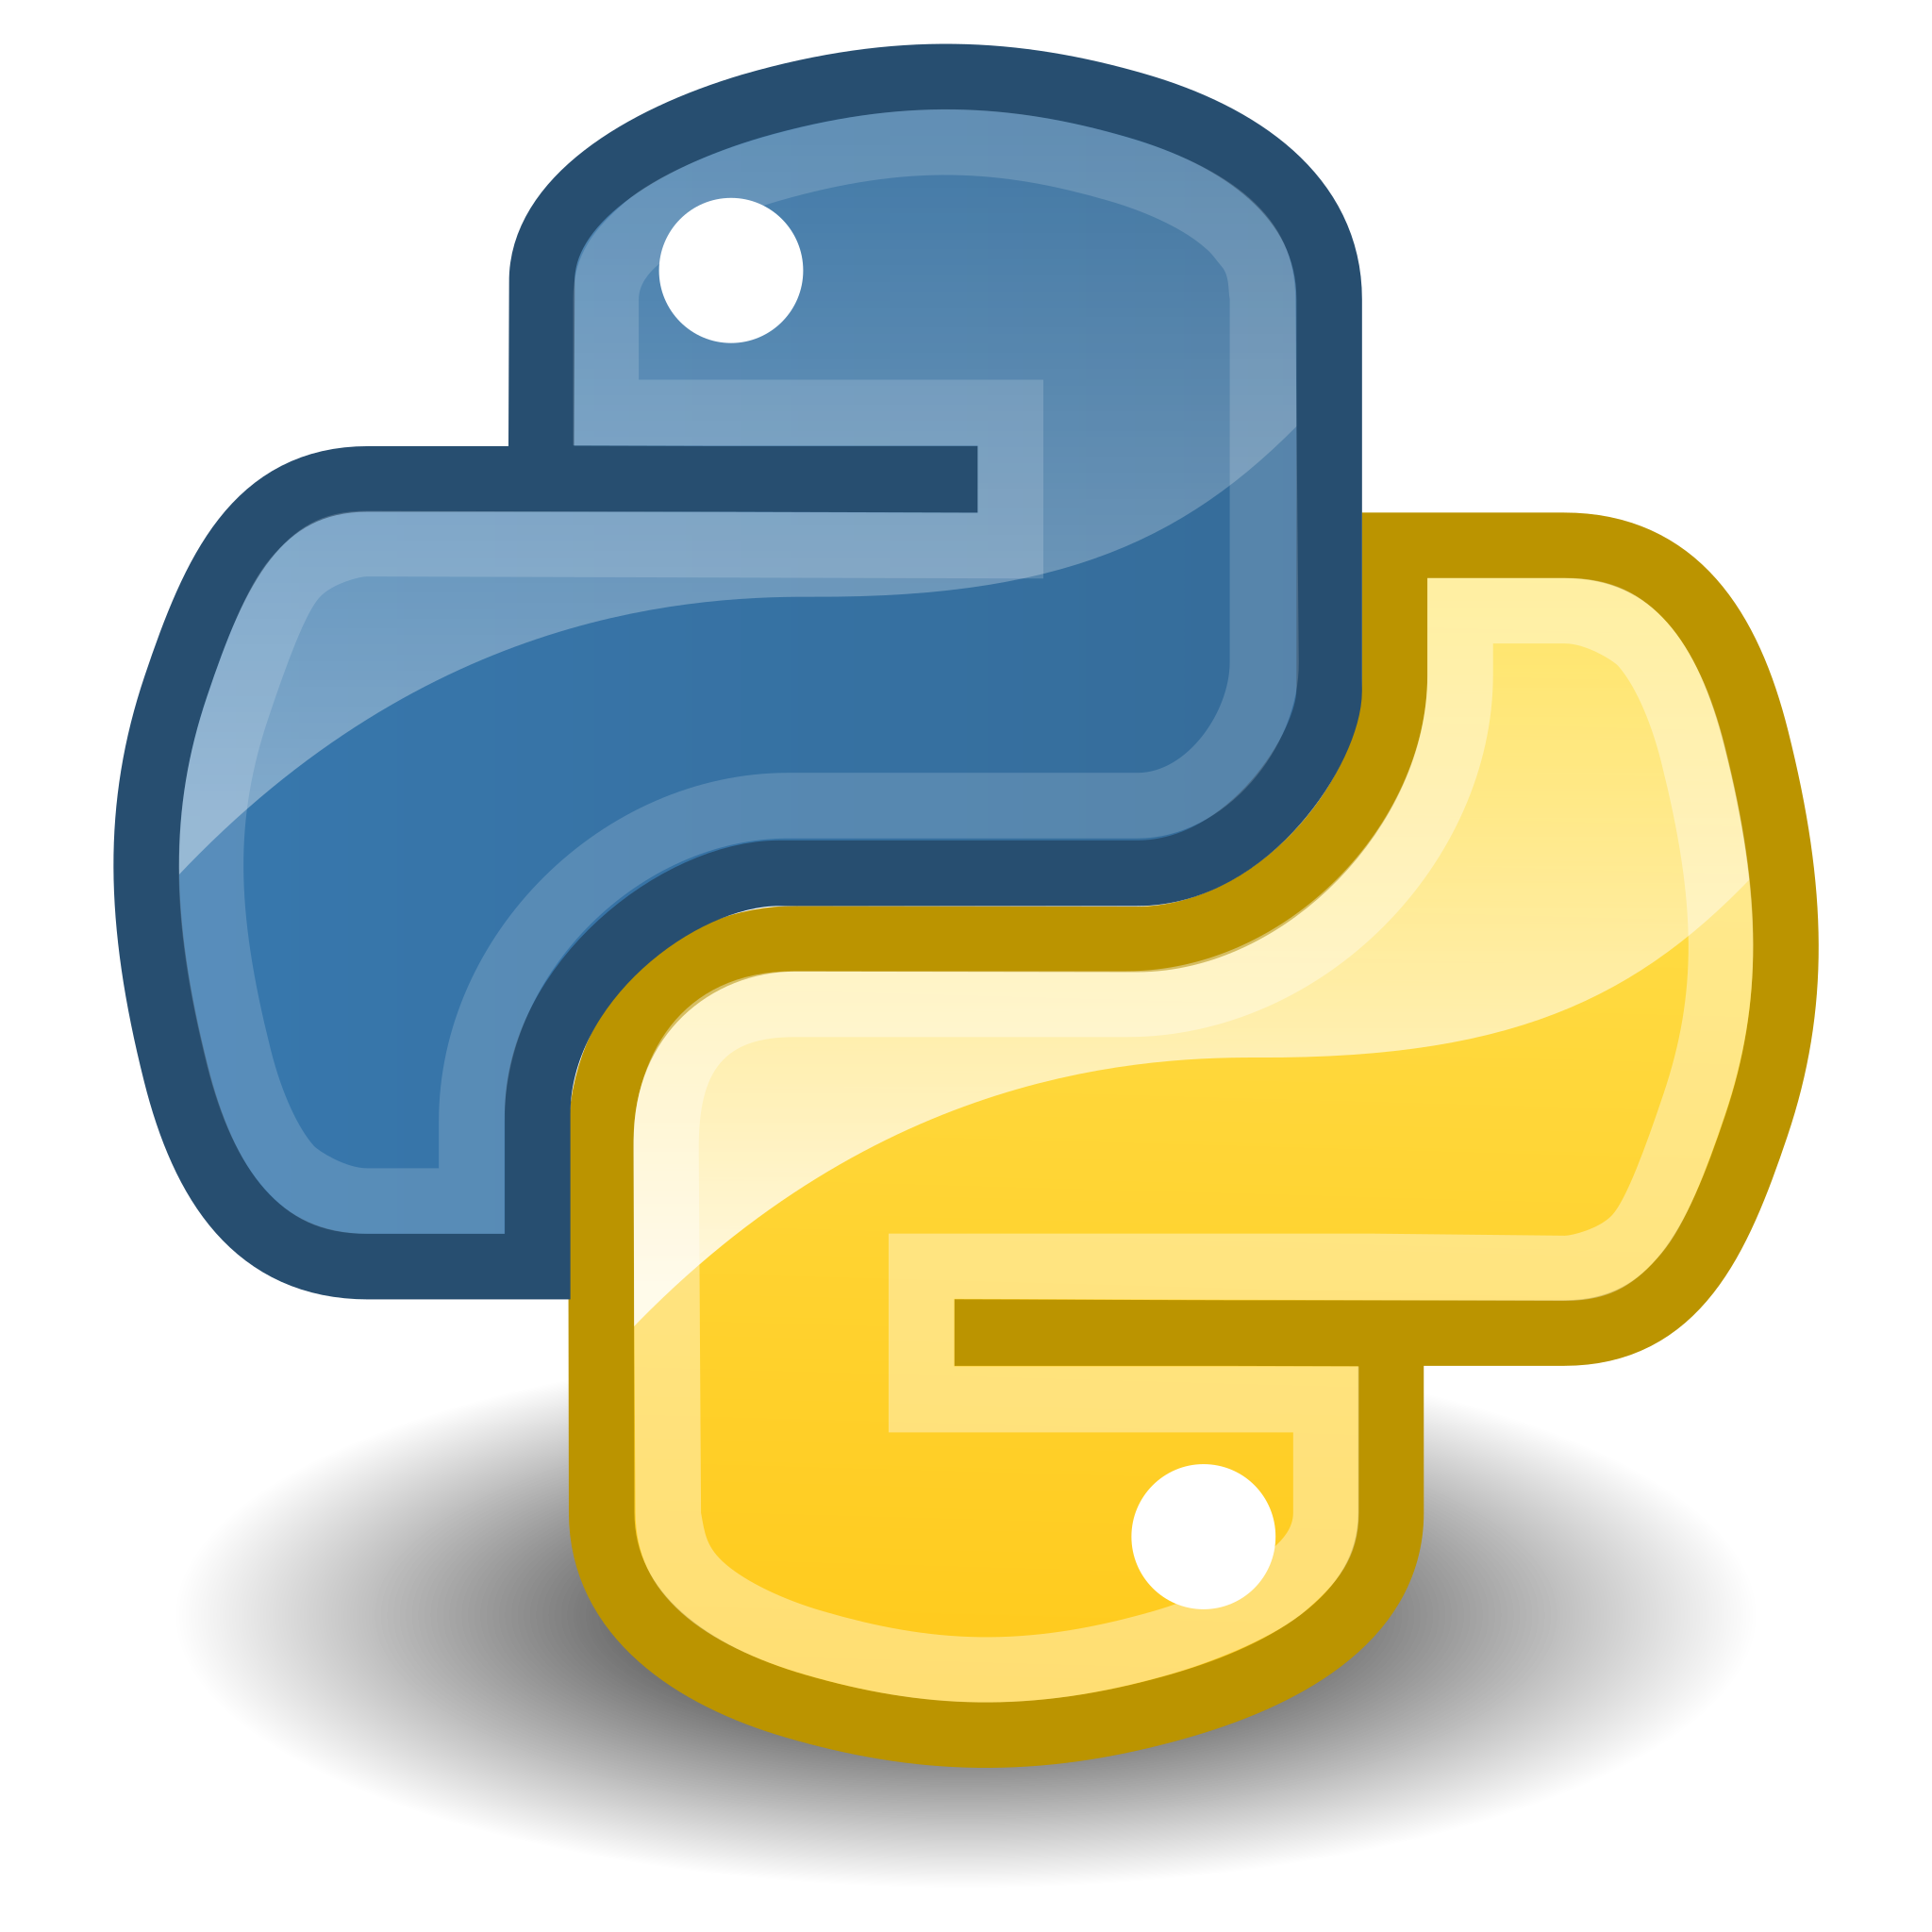

Collaborative Tools
GUI for MNE-Python (MNELAB)
Easily importing MEG data from the Human Connectome Project for use with MNE-Python (MNE-HCP)
Managing MNE projects so that they comply with the Brain Imaging Data Structure specification (MNE-BIDS)
Automatic bad channel detection and interpolation (autoreject)
ICA with good performance on real data (PICARD)
Automatic labeling of ICA components (MNE-ICAlabel)
Phase-amplitude coupling (pactools)
Representational similarity analysis (rsa)
Other connectivity algorithms (MNE-Connectivity)
General-purpose statistical analysis of M/EEG data (eelbrain)
etc.

Slide 11
Example Usage in the Jupyter notebooks…

Slide 12
Resources
https://mne.tools/stable/index.html
https://neuraldatascience.io/intro.html
https://mne.tools/mne-python-intro-slides/

Slide 13
Thank You for Your Attention and Engagement !

